Slide 1
Midterm Review
Chapter 1
Basic concepts: classification, clustering, regression, association rule discovery, anomaly detection
Chapter 2
Attributes (Types, Properties, Discrete and Continuous attributes, Symmetric and Asymmetric attributes)
Data Quality, Noise, Outliers, Missing Values, Duplicate data
Data Preprocessing Techniques, Curse of dimensionality and Dimensionality Reduction
Similarity and Distance Measures (Euclidean, Minkowski, Jaccard, Tanimoto, SMC, Cosine)
Properties of a distance or similarity metric
Correlation coefficient
Weighted similarity and distance
Chapter 3
Summary Statistics (Frequency, Mode, Percentiles, Mean, Median, Range, Variance)
Visualization techniques (Histograms, Box plots, Pie charts, Scatter plots, Contour plots, Matrix plots, Correlation matrix)

Slide 2
Midterm Review
Chapter 4
Decision Trees (Hunt’s algorithm, measures of node impurity: Gini, Entropy, Misclassification error, Computing impurities for nominal, binary and continuous attributes, Gain, Gain Ratio, Split Info, Generalization and re-substitution errors, optimistic and pessimistic errors, reduced error pruning, Pre-pruning and post-pruning)
Over-fitting and Under-fitting
Bias-Variance Tradeoff
Performance evaluation of a model (accuracy, TP, FP, TN, FN, TPR, TNR, FPR, FNR, Precision, Recall, F-measure, Cost matrix)
Methods of estimation (Holdout, random subsampling, cross validation, leave-one-out validation, bootstrap sampling)
ROC curves

Slide 3
Practice Problem 1
Let x = {0,1,0,1} and y = {1,0,1,0} be two vectors. Find their cosine similarity, Jaccard similarity, Euclidean distance and correlation coefficient.
Answer:
Cos(x,y) = 0
Corr(x,y) = -1
Euclidean(x,y) = 2
Jaccard(x,y) = 0

Slide 4
Practice Problem 3
Let x and y be any two vectors (of dimension n each) where each vector has a mean of 0 and standard deviation of 1. Find the relation between their Euclidean distance and correlation coefficient.

Slide 5
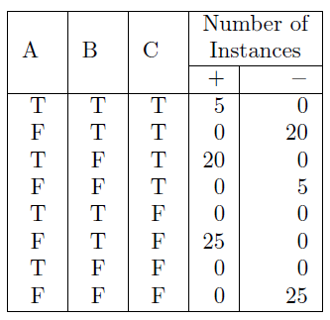
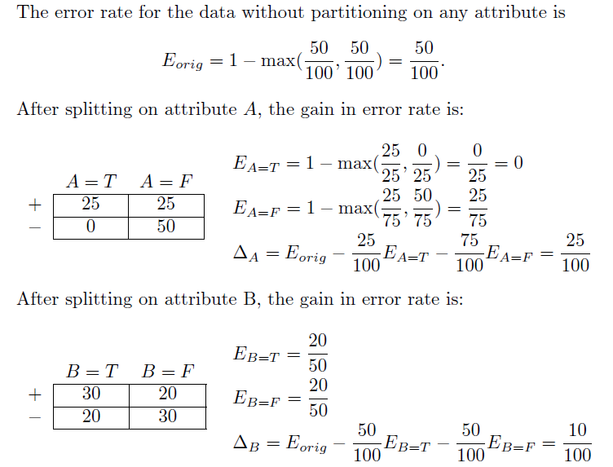
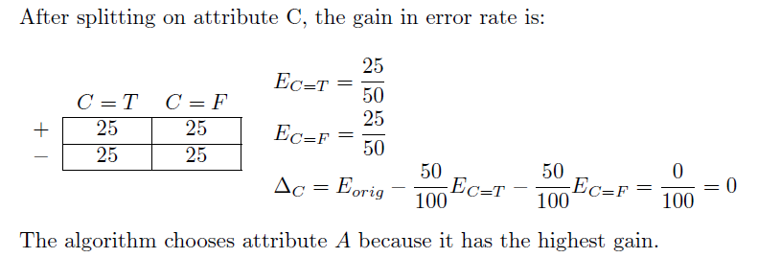
Practice Problem 4
Consider the following training data for a binary classification problem. According to the misclassification error measure, which attribute will be chosen as the first splitting attribute?

Slide 6
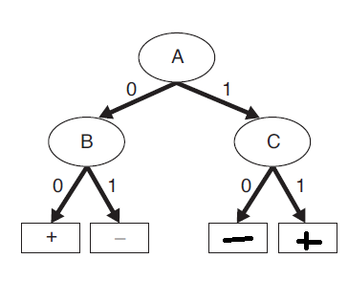
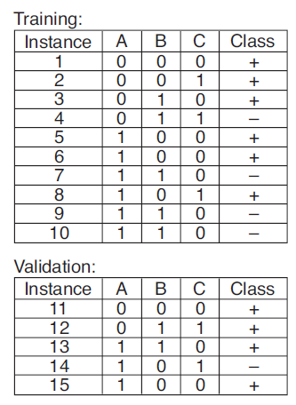
Practice Problem 5
Consider the decision tree and the training and validation sets.
Compute the generalization error of the tree using the optimistic approach
Compute the generalization error using the pessimistic approach (use a penalty of 0.5 for each leaf node)
Compute the generalization error using the optimistic approach on the validation set
(a) 3 examples are misclassified in the training set. Optimistic error = 3/10 = 0.3
(b) Pessimistic error = (3 + 0.5*4)/10 = 0.5
(c) 4 examples are misclassified in the validation set. Optimistic error on the validation set = 4/5 = 0.8

